Slide 1
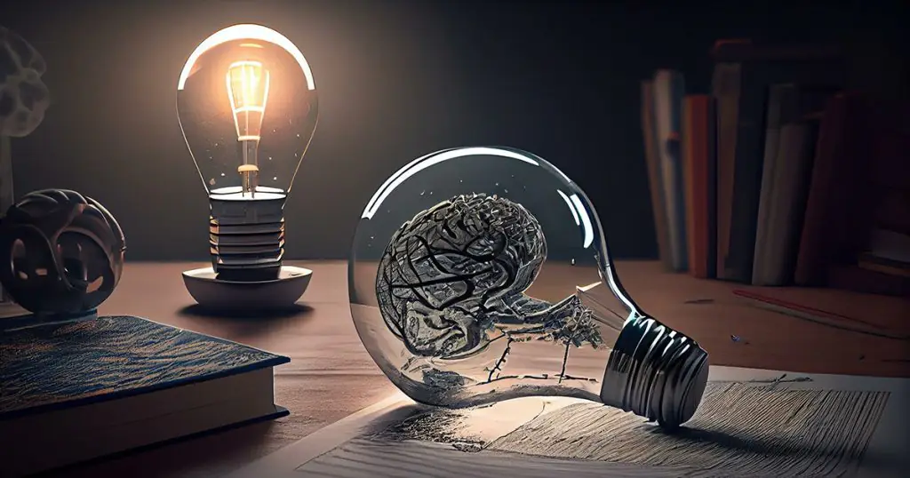
Intellectual Property “Intellectual property (IP) is a category of property that includes intangible creations of the human intellect.”
Sanjeeva Perera - Senior Academic Fellow
Department of Computer Systems Engineering,
Faculty of Computing

Slide 2
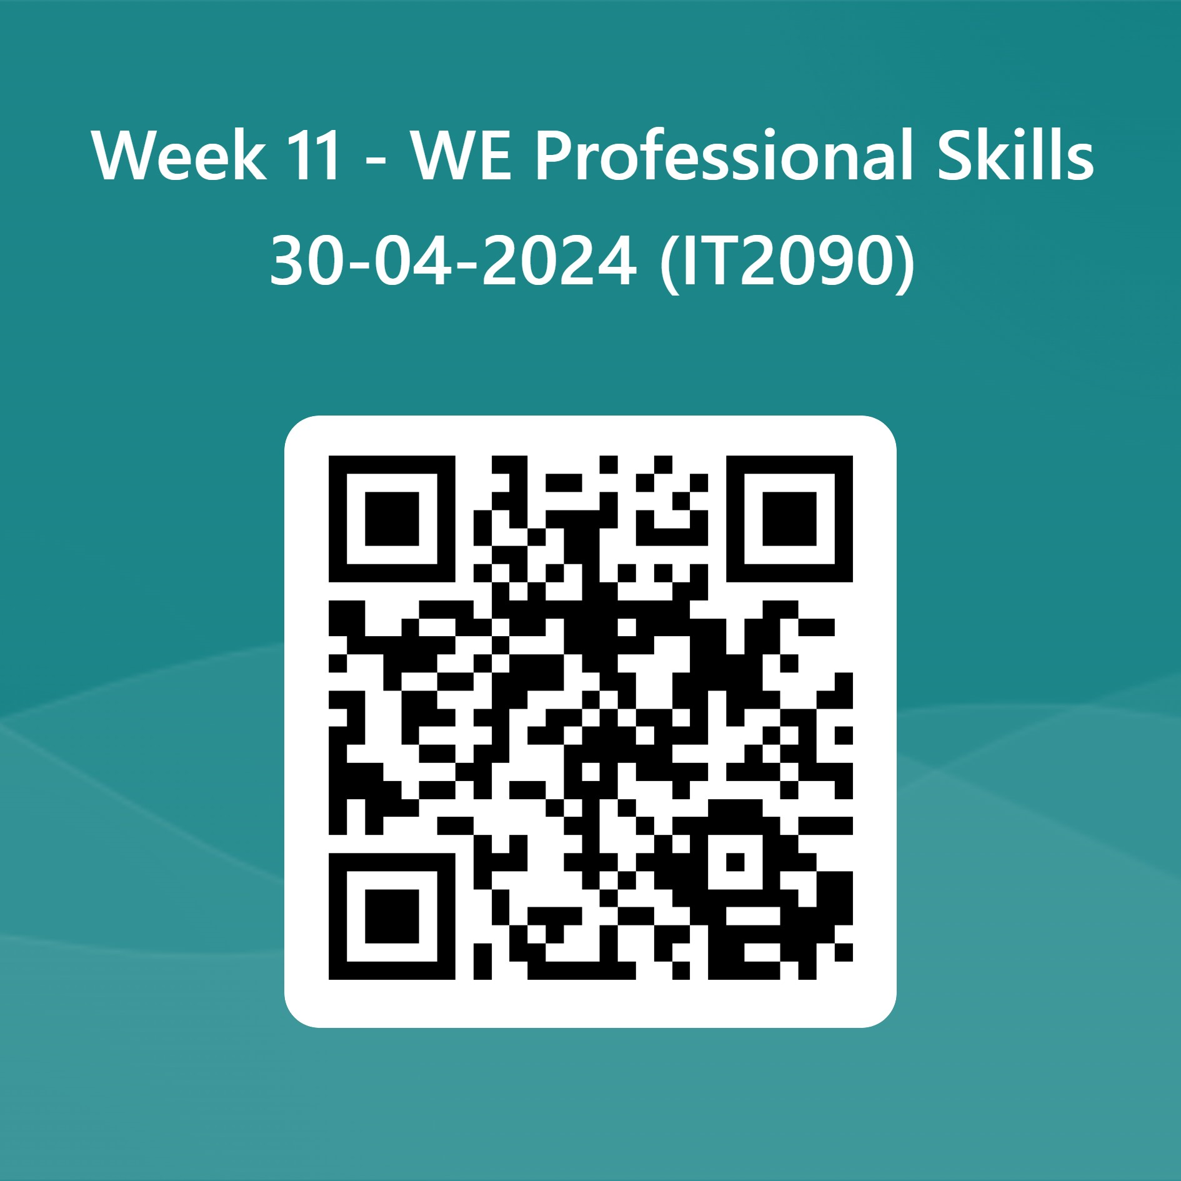
Attendance WE https://forms.office.com/r/bxVTM2Cr8Z

Slide 3
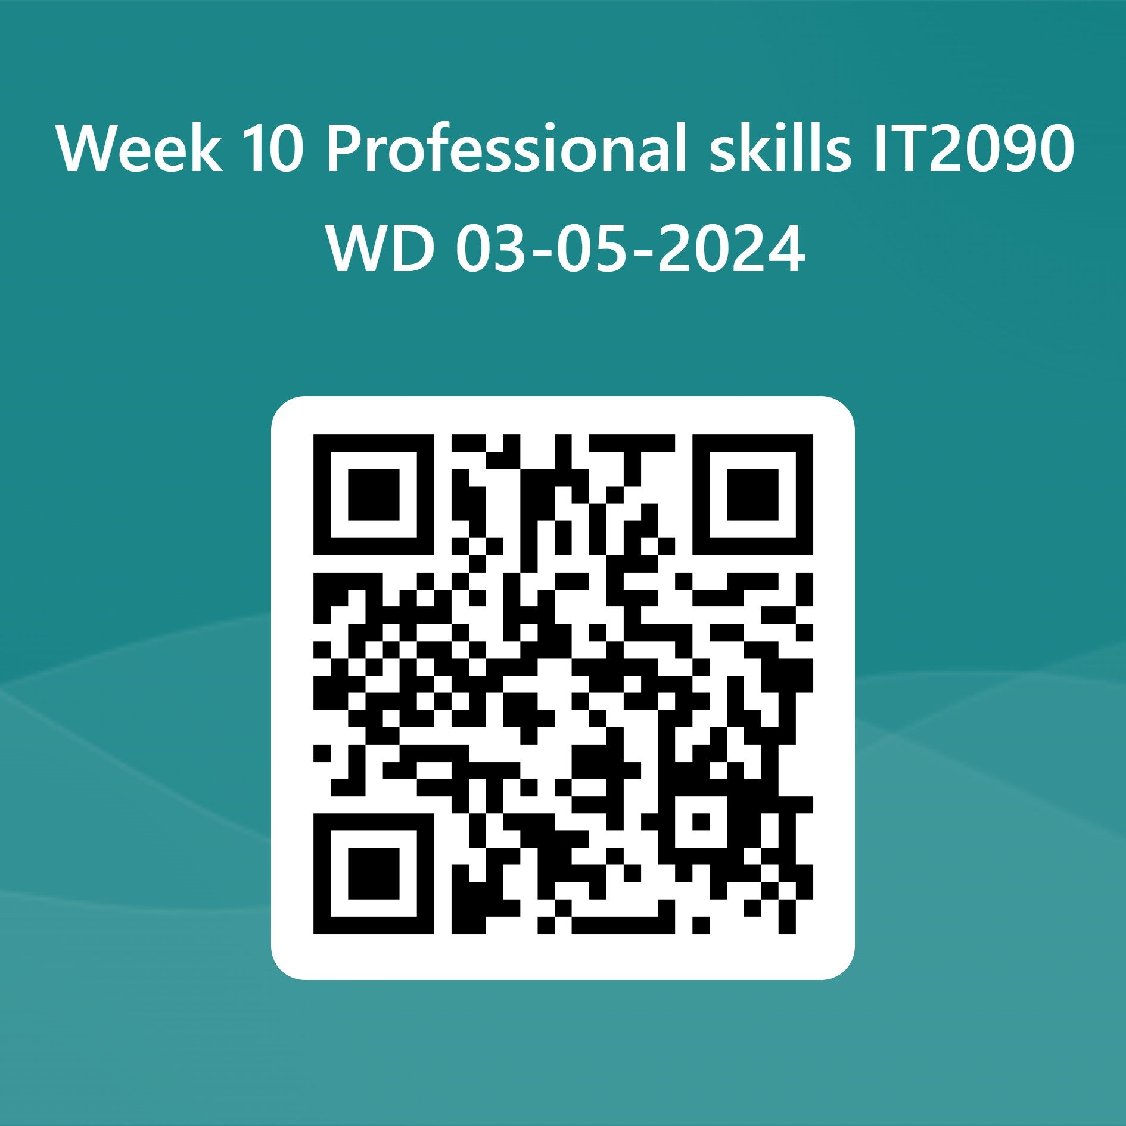
Attendance WD https://forms.office.com/r/8yZnWPh8Fq

Slide 4
Intellectual Property

Slide 5
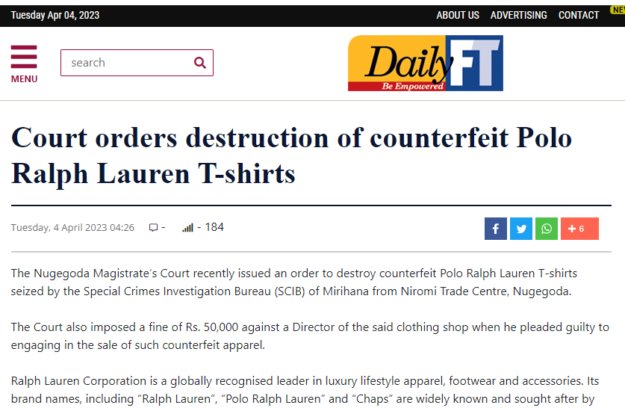

Slide 6
Agenda
What is IP?
Type of IP
IP System of Sri Lanka
What is a Patent and How it can be filed?
Why? What? Who? When? Where?
Wealth of a Nation
Licensing and Software Piracy
Fair Use
Open Source Software
Trademarks, Copywrites, Proprietary License, Reverse Engineering, Trade Secrets

Slide 7
Intellectual property
intellectual property (IP): Any intangible asset that consists of human knowledge and ideas.
patents, copyrights, trade secrets, trademarks, contracts
intent: to encourage ingenuity and protect creative ventures
"value" of an intellectual asset:
Most such assets cannot be recognized on a balance sheet when internally generated, since it is very difficult to objectively value intellectual property assets.
They can be included in a balance sheet if acquired, which allows more accurate valuation for the asset (the acquisition cost).

Slide 8
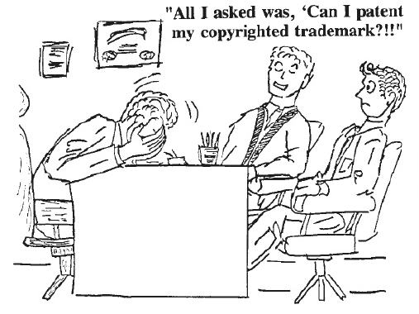

Slide 9
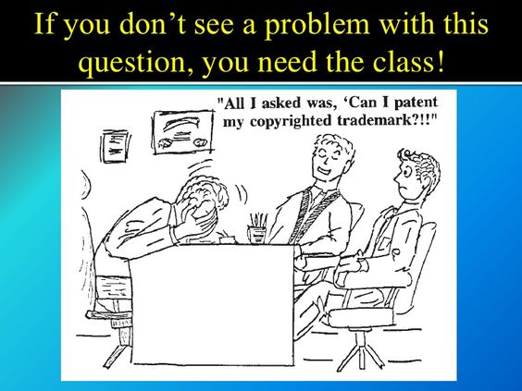

Slide 10
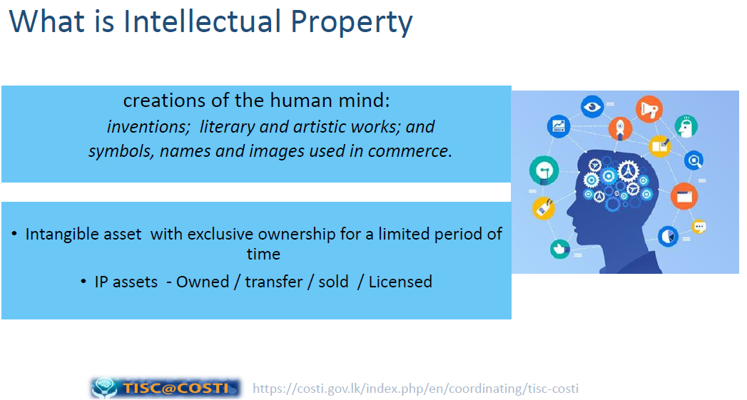

Slide 11
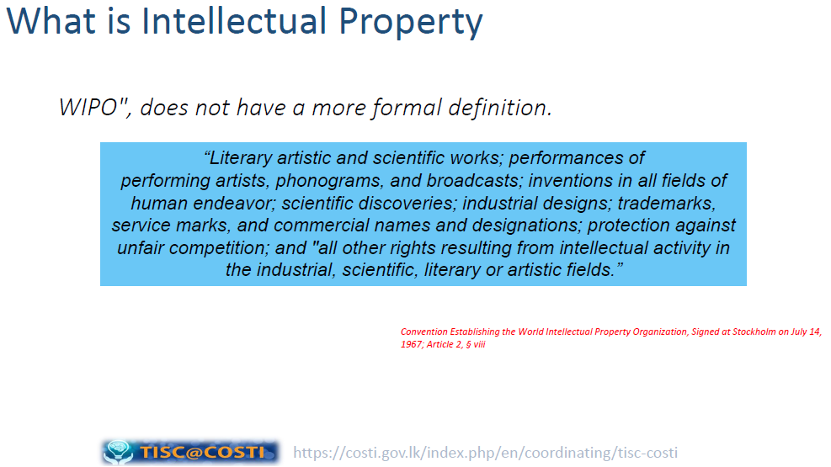

Slide 12
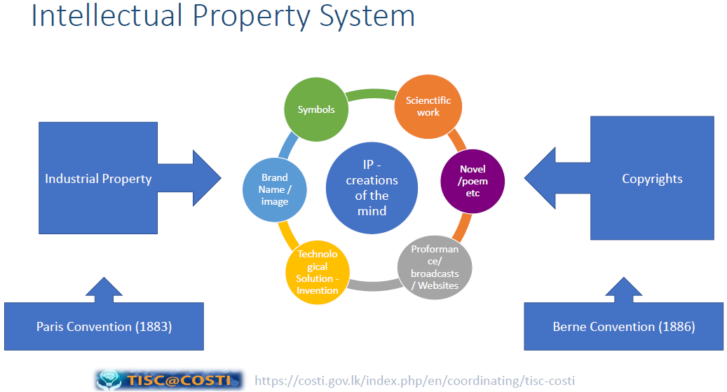

Slide 13
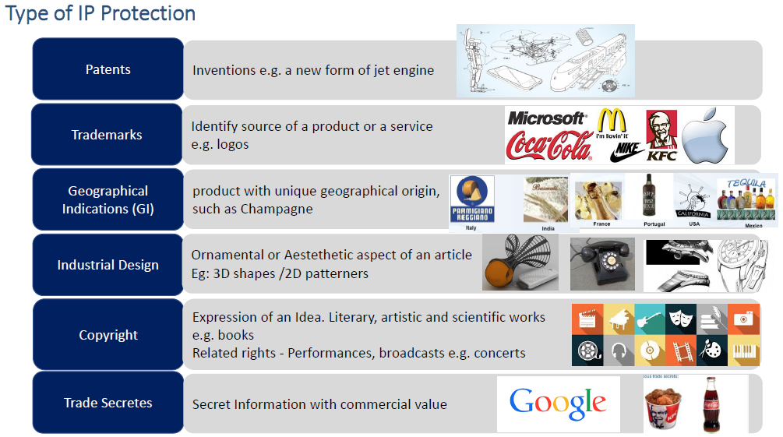
Champagne is a sparkling wine originated and produced in the Champagne wine region of France under the rules of the appellation, which demand specific vineyard practices, sourcing of grapes exclusively

Slide 14
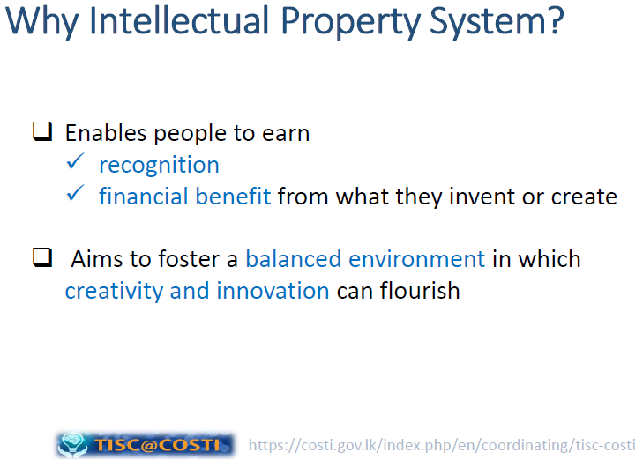

Slide 15
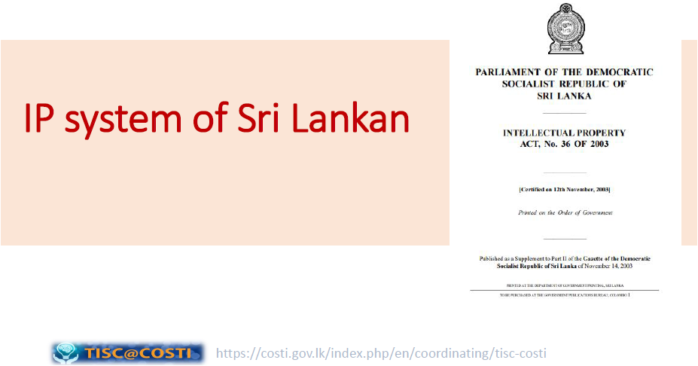


Slide 16
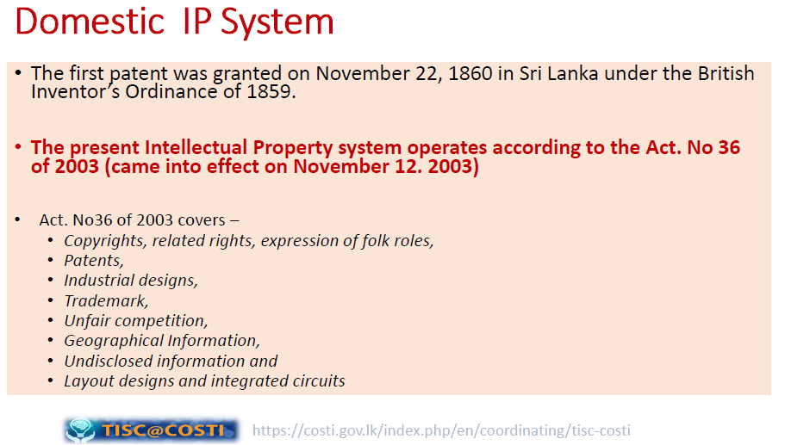

Slide 17
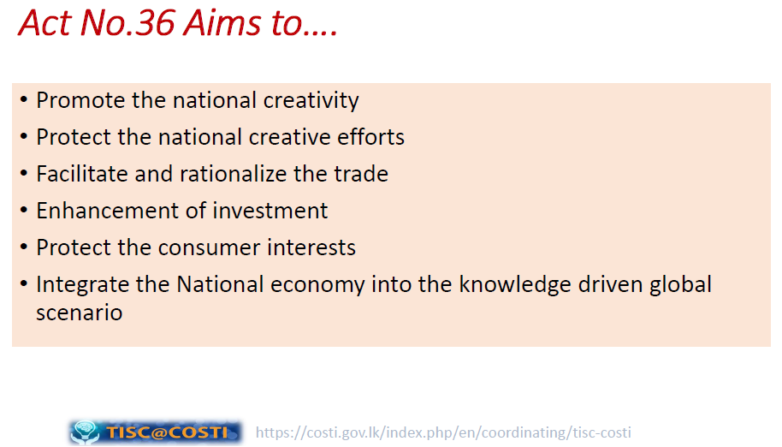

Slide 18
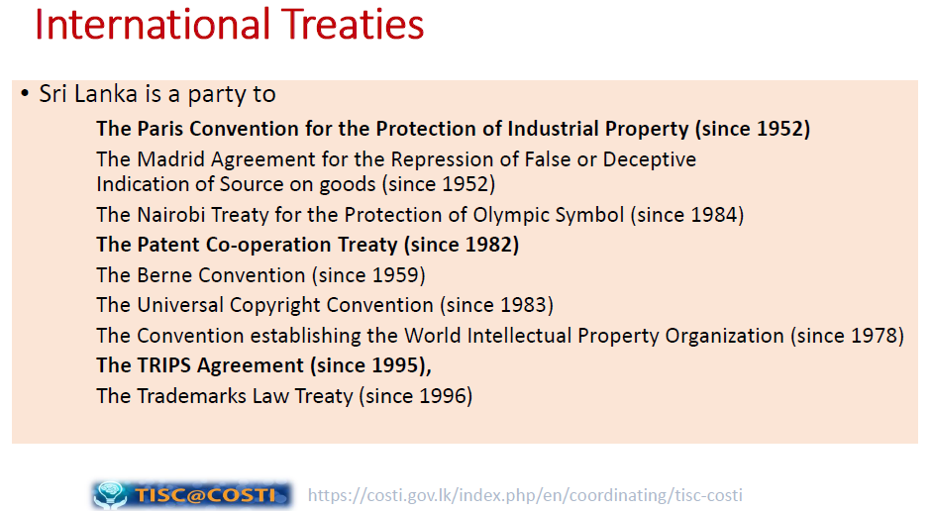

Slide 19
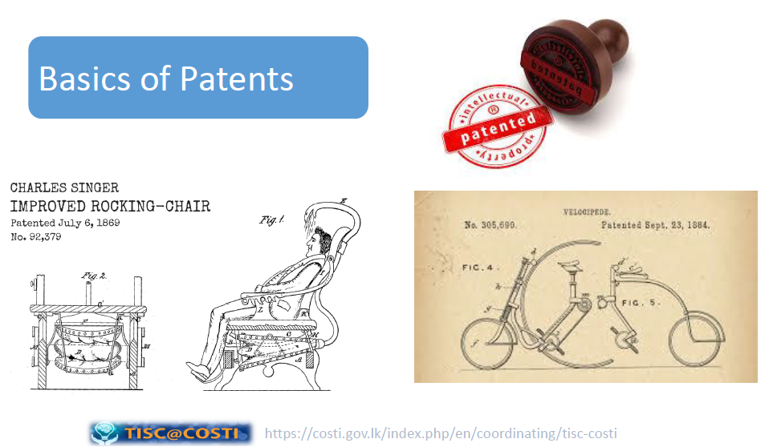

Slide 20
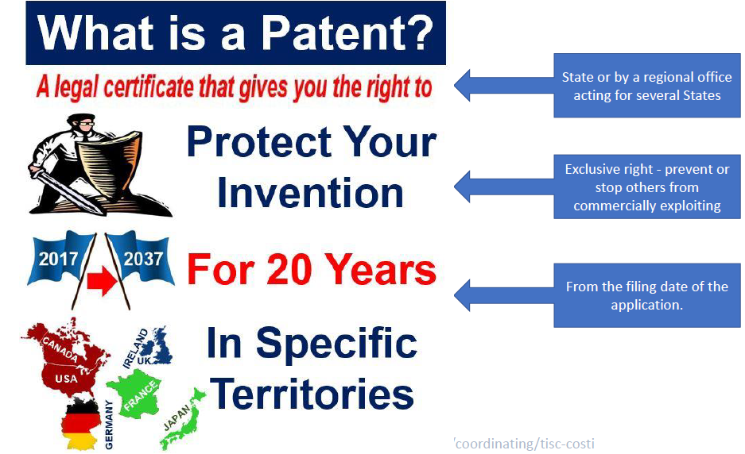

Slide 21
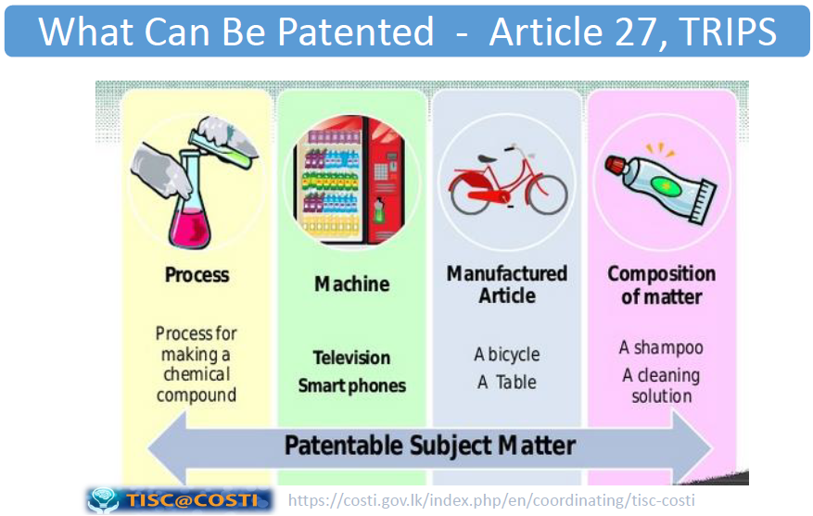

Slide 22
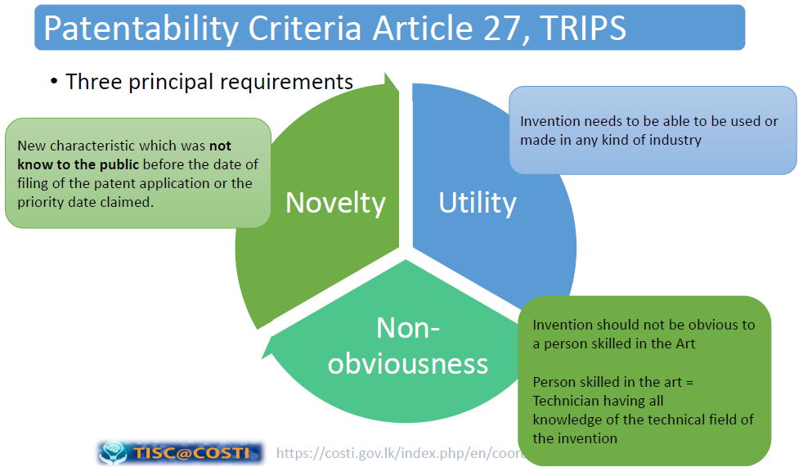

Slide 23
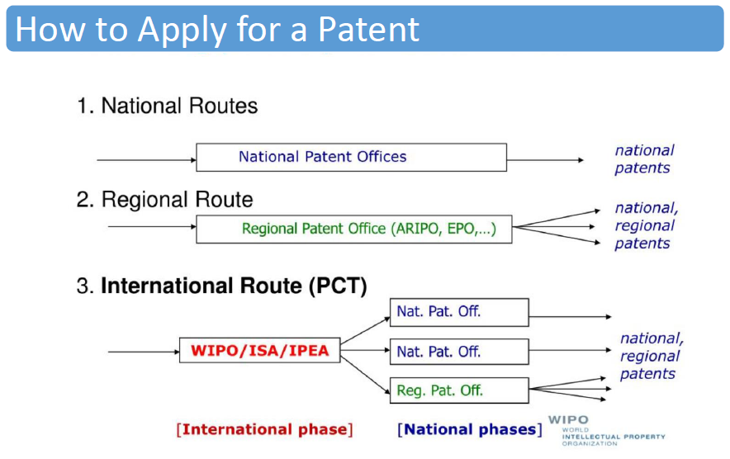

Slide 24
US Patent Process
Publication of
Application at 18 mos.
Appeal or Request Continued Examination
Examiner is
Assigned
3 mos.
12 months
6 months
6 months
File
US Application
Examiner searches prior art and issues Office Action
Inventor responds to Office Action
Notice of Allowance or Final Rejection

Slide 25
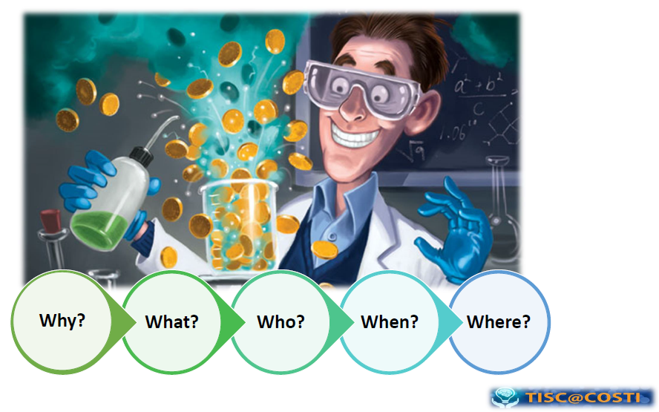

Slide 26
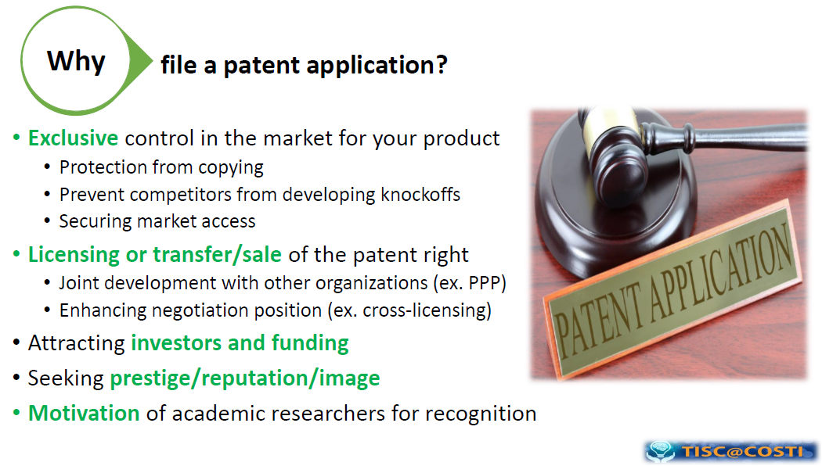

Slide 27
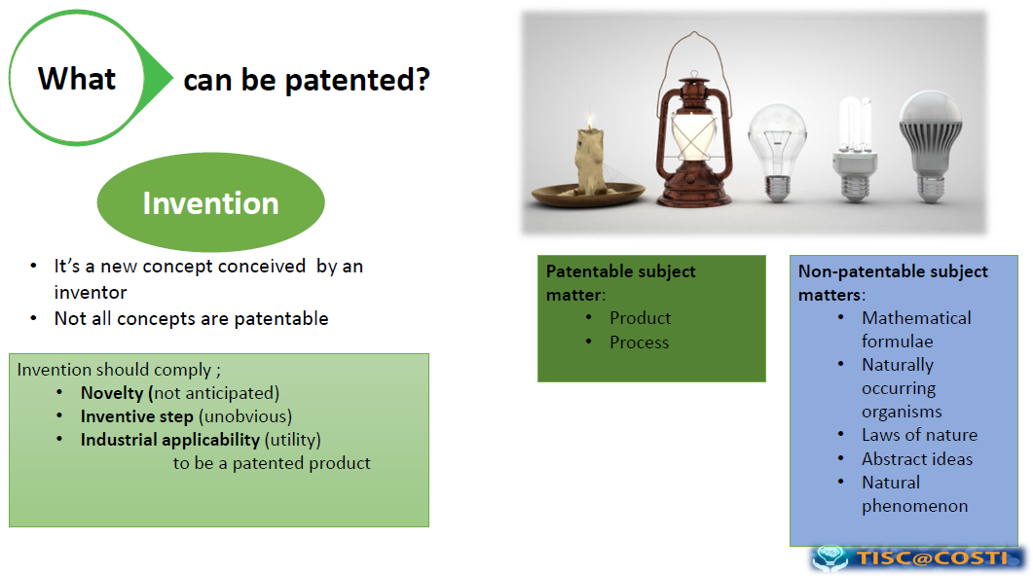

Slide 28
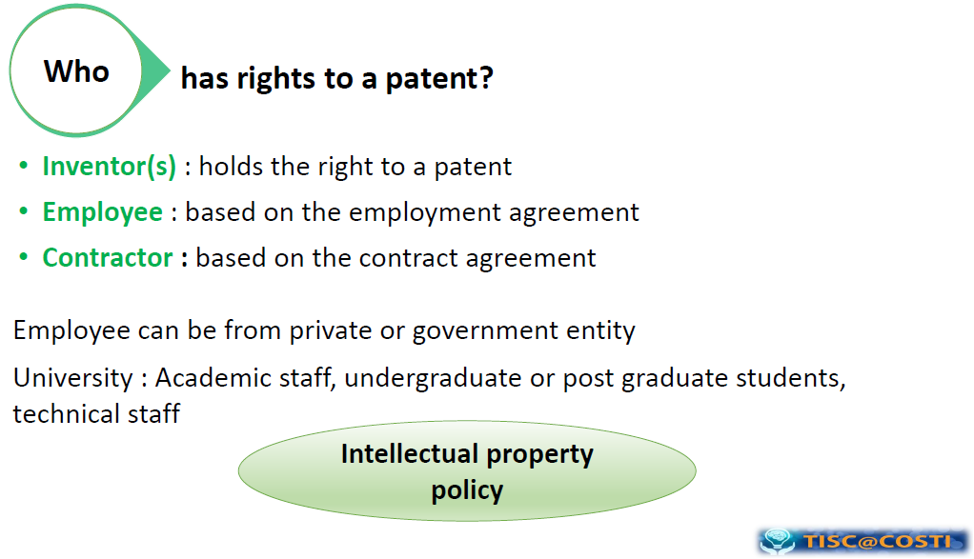

Slide 29
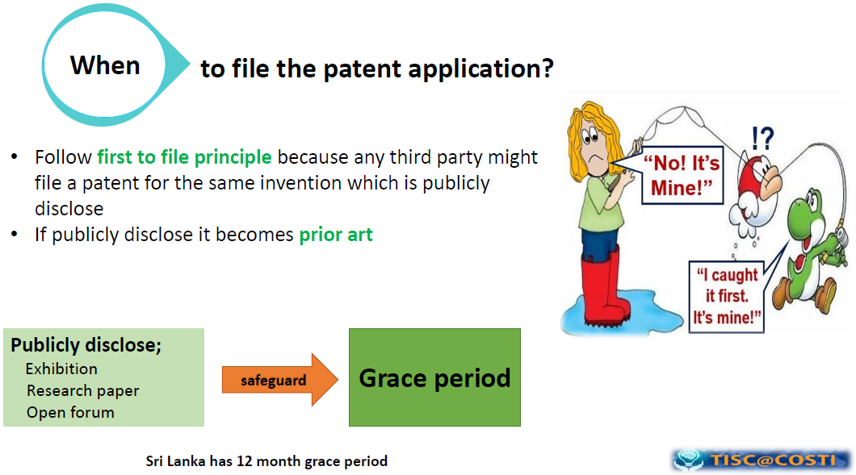

Slide 30
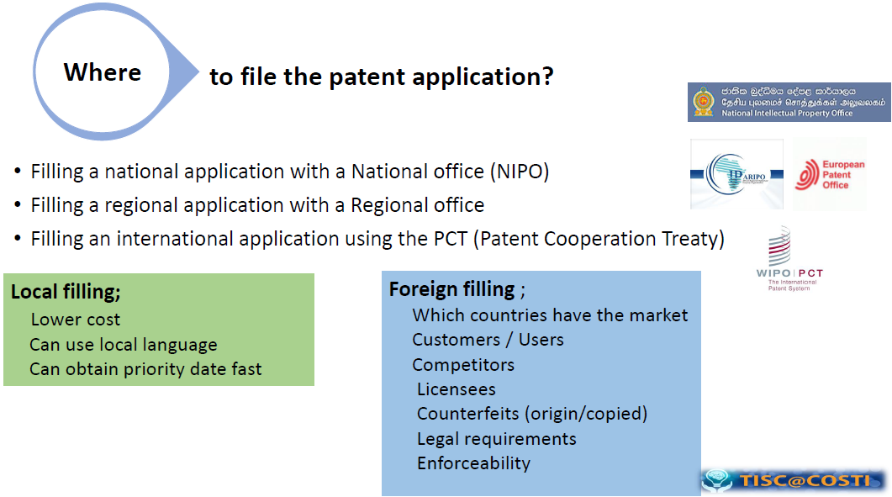

Slide 31
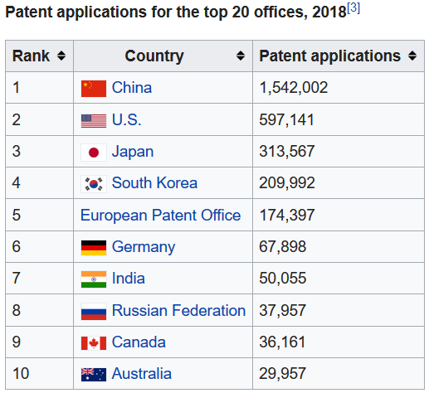
Wealth of a Nation

Slide 32
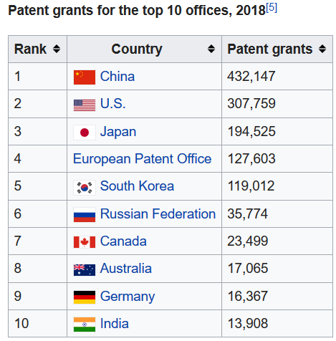
Wealth of a Nation

Slide 33
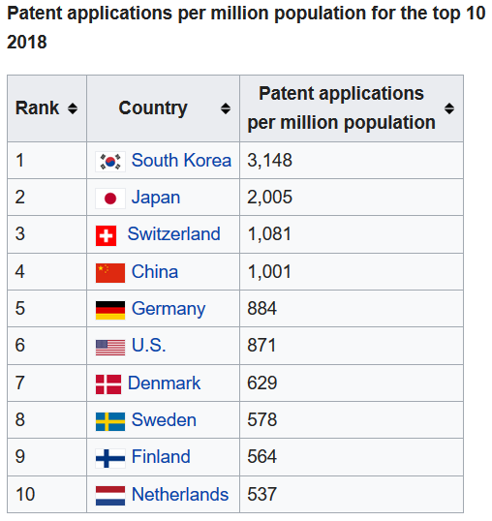
Wealth of a Nation

Slide 34
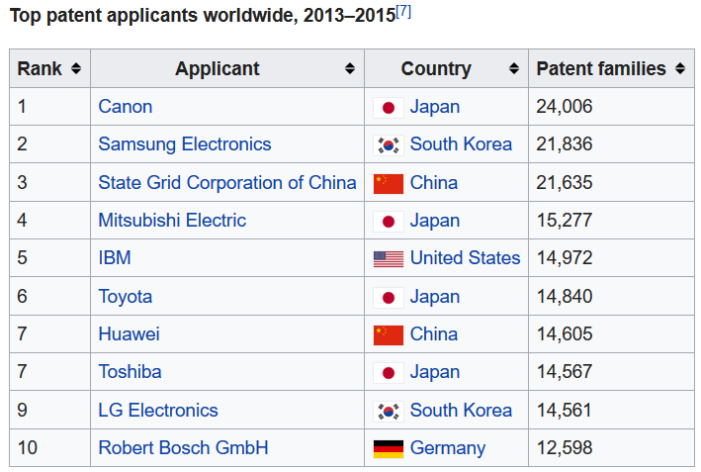
Wealth of a Nation

Slide 35
Licensing of an IP
Licence is a permission that an IP owner grant to another person to use the IP on agreed terms and conditions, while he continues to retain ownership of the IP
Licensing creates an income source
It establishes a legal framework for transfer of technology to a wider group of researchers and engineers
Creates market presence for the technology or trademark

Slide 36
Software Piracy
Software piracy is the unauthorized and illegal duplication of copyrighted software.
Covers in Sri Lanka Intellectual Property Act, No. 36 of2003
In general, you do not have the right to copy, loan, rent, or in any way distribute the software, unless otherwise specified in the license.
The commercial value of pirated software is $19 billion in North America and Western Europe and has reached $27.3 billion in the rest of the world.
According to the 2018 Global Software Survey, 37% of software installed on personal computers is unlicensed software

Slide 37
Software Piracy
Five major types of software piracy could be classified:
Soft-lifting (is the act of purchasing a single copy of software and then downloading it onto more than one computer, despite agreement terms stating the software must only be downloaded once.)
Client-Server Overuse ( that happens when the number of users of a particular piece of software exceeds the number of licenses. It occurs when a program is installed on a local area network accessed by multiple users at the same time without putting any restrictions on the number of people using the software in place)
Internet Piracy (occurs when software is downloaded from any site other than the publisher’s official distribution stream)
Hard-Disk Loading (happens when a business installs unauthorized copies of software onto the hard disks of any computers it sells)
Software Counterfeiting (is usually what people think of when they hear the term “software piracy.” Counterfeiting is the illegal reproduction and distribution or sale of copyrighted material.)

Slide 38
Copyright law protects certain exclusive rights of copyright holders.
However, copyright law does allow limited copying, distribution, and display of copyrighted works without the author's permission, under certain conditions known as "fair use“.
Fair Use

Slide 39
Fair Use
Here are the four standards:
The purpose and character of the use. including whether such use is of a commercial nature or is for nonprofit educational purposes;
The nature of the copyrighted work.
The amount and substantiality of the portion used in relation to the copyrighted work as a whole
The effect of use on the potential market for or value of the work.

Slide 40
Open-Source Software
Source code to software ought to be freely distributed
Encourage to examine and improve other’s code
New version of software appear much more frequently
Eliminate tension between obeying copyright law and helping others
Anyone can make money by providing support, those who provide best support would be rewarded
Ex: Apache web servers, Linux OS

Slide 41
Trademarks
Protects: any word, name, symbol, or device, or any combination thereof used to distinguish goods from others
Protects against: others using the mark, likelihood of confusion and dilution
Excluded: use in other industries / geographic areas
Requirements: use mark in commerce or register with intent to do so in future; must maintain quality control over goods
Term: 10 year renewable (no upper limit)
Is your project's name trademarked?
http://tess2.uspto.gov/

Slide 42

Copyright
Protects: expression of ideas in a medium, but not the ideas
Protects against: reproduction, copy distribution, derivative work creation (NOT independent creation of same/similar work)
Requirements: original work, fixed in tangible form
Term: author's life + 70 years
Cost: simple

Slide 43
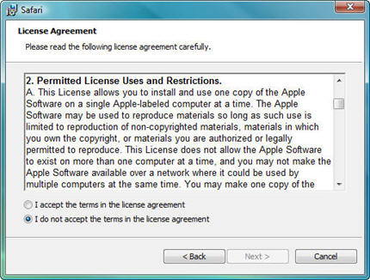
Proprietary licenses
most proprietary ($) software is licensed, not sold
publisher grants you a "license" to use a copy of the software
ownership of those copies stays with the software publisher
reserves for the owner almost all rights
grants only a limited set of rights to the end-user
Without accepting the license, the end-user may generally not use the software at all
Are EULAs enforceable?
never fully challenged in court
(without a settlement)

Slide 44
Reverse engineering
reverse engineer: take something apart to see how it works
In software, this usually means decompilation (converting from object code to source code)
As reverse engineering is based on a copy of a piece of software, it is almost always in violation of copyright unless the right to do so is explicitly granted
However, if decompilation is needed to attain interoperability, US and European copyright laws permit it in some cases
One US example allowed a company to decompile to get around a software locking mechanism for a Sega game console

Slide 45
Trade secret
Protects: concept, idea, info, or innovation
Protects against: misappropriation (NOT independent creation of same work)
Requirements:
info not generally known or available
must spend reasonable effort to maintain secrecy
company derives some (economic) value from secrecy
Term: no predefined limit
Cost: no registration or examination

Slide 46


Trade secret examples
Symantec said Veritas shared trade secrets and even trained Microsoft engineers as the companies began working together
Microsoft used trade secrets to start developing products [Vista] that directly competed with their offerings, the lawsuit said.
Microsoft said that in 2004 it bought from Veritas the rights to the technologies in question

Slide 47
Protect your Intellectual Property
Register the Appropriate IP Protection
The strongest protection comes from registering your work. By doing so, you put your claim into the public view, discouraging many (but not all) people from using your work without permission.
Trademark registration
Fill a trademark application on its main brand and apply for registration

Slide 48
Protect your Intellectual Property
A patent or provisional patent
Fill a provisional patent application and apply for the patent to protect your creation.
Registering your copyright
Protect trade secrets
Establish policies and procedures to demonstrate ownership

Slide 49
Summary
What is IP?
Type of IP
IP System of Sri Lanka
What is a Patent and How it can be filed?
Why? What? Who? When? Where?
Wealth of a Nation
Licensing and Software Piracy
Fair Use
Open Source Software
Trademarks, Copywrites, Proprietary License, Reverse Engineering, Trade Secrets

Slide 50
Questions ?

